Slide 1

Keyword Extraction From The News Feed Or Blogposts With IBM Cloud
Team : cse-11
SANJANA
VEENA
RITIKAA
SUBRAMANYAM
ASHOK

Slide 2

INTRODUCTION
Keyword extraction is the automated process of extracting the most relevant words and expressions from the text. With more than 290 billion emails sent and received on a daily basis, and half a million tweets posted every single minute, using machines to analyze huge sets of data and extract important information is definitely a game-changer. We are building a flask application by using a keywords extraction API.
This API uses advanced Natural Language Processing techniques to extract the most important 'Keywords' and 'Phrases' from a LIST of text or URL that you provide. It can take any type of text as input and will perform best on URLs corresponding to news, blog, content, etc. It can also take MULTIPLE text or URLs as input and you can specify the number of keywords that need to be extracted

Slide 3
Architecture
http Request
API
UI
http Response
Keyword Extractor with API
USER

Slide 4

Problem statement :
Keyword Extraction From The News Feed Or Blogposts With IBM Cloud
PROBLEM SOLUTION :
Lets get into the Solution

Slide 5
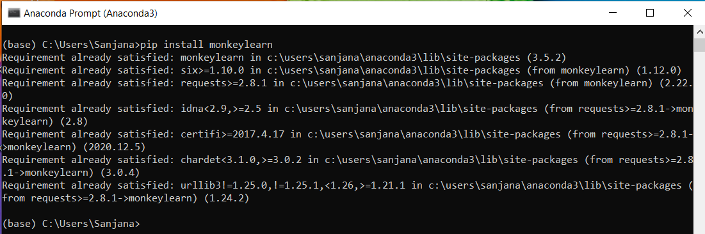
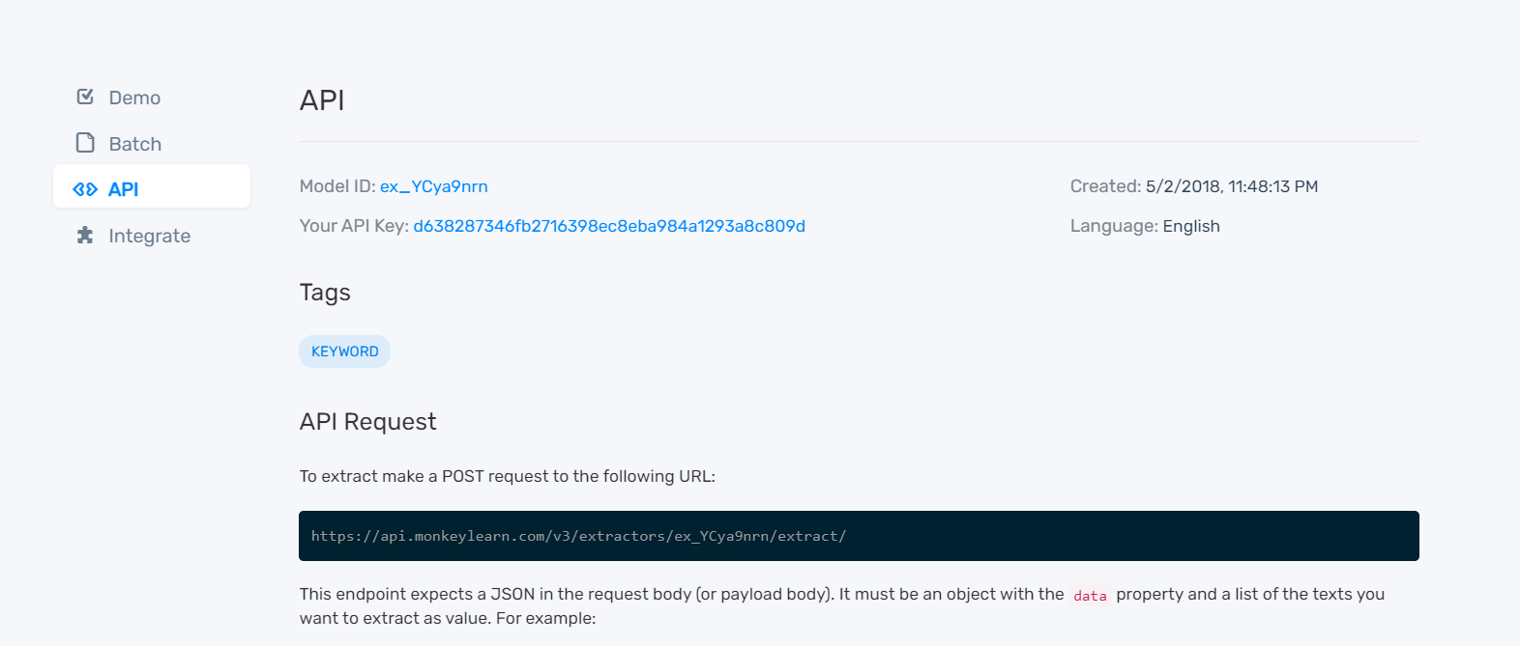
Sign up and login procedure
Open Anaconda Prompt and install monkeylearn
Command : pip install monkeylearn
https://monkeylearn.com/signup/
Signup with your email_id
Now login into the account and you will be welcomed to the dashboard.
Now copy API key and Model ID provide in the page

Slide 6
BUILDING THE FLASK APP

Slide 7
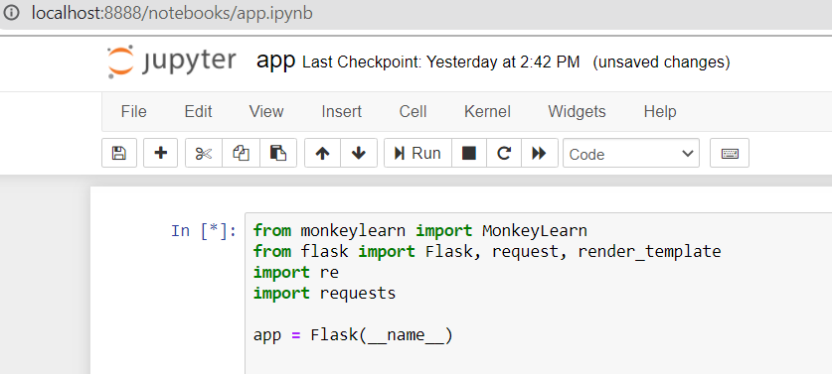
IMPORTING LIBRARIES
Now, our API key is ready to be used and integrated with the app.
Let’s start with building it.
Import monkeylearn and import the libraries and initiating flask app
Flask: It is our framework which we are going to use to run/serve our application. IMPORTING LIBRARIES
render_template: used for rendering the HTML pages
re : It is a regular expression which supports various things like Modifiers, Identifiers, and White space characters.
## app = Flask(__name__) > It creates an instance saying that we are creating a flask app with the name “app”

Slide 8
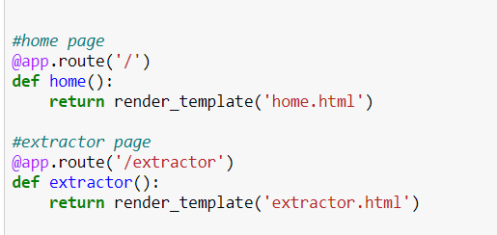
CONFIGURE THE HOME PAGE AND EXTRACTOR
Use the templates to render the home page and when clicked on the extractor, load the page for the user to interact with the app and input the data.
>@app.route('/') # app is routed with the URL '/’ –in the localhost:5000
>@app.route(‘/extractor’)# app is routed with the URL ‘/extractor’ –in the localhost:5000

Slide 9
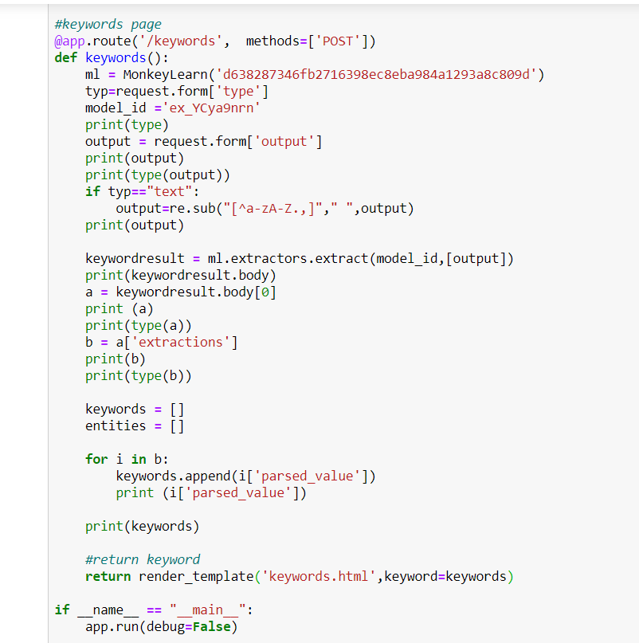
CONFIGURE THE RESULTS PAGE
Use your API Key and model id in define function .
We have to call the function defined above to get the output.
If the user chooses to provide their own text, then we have to do the pre-processing on the code as well
> app.run(debug = True) # your app runs in local host - localhost:5000

Slide 10
EXCEUTION OF THE CODE
Run the flask application using the run method. By default, the flask runs on Port number 5000. If the port is to be changed, an argument can be passed to do so.
In anaconda prompt, navigate to the folder in which the flask app is present. When the python file is executed the localhost is activated on 5000 port and can be accessed through it.
HOME Webpage is DISPLAYED

Slide 11
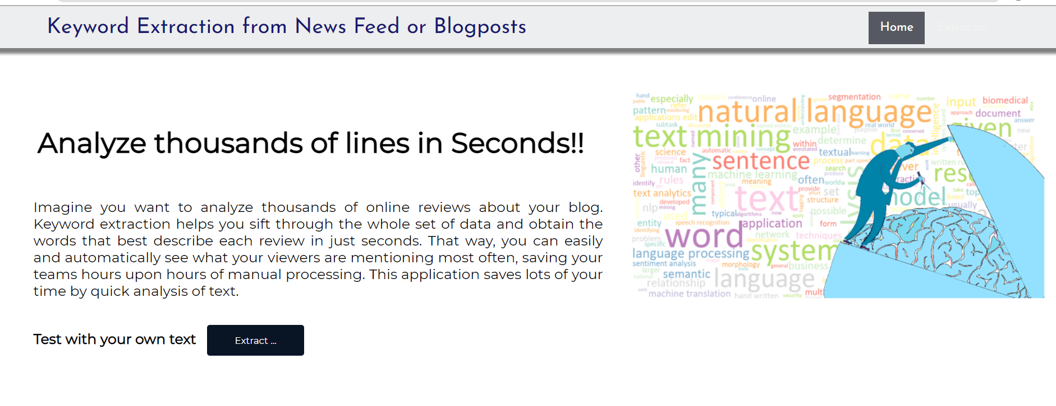
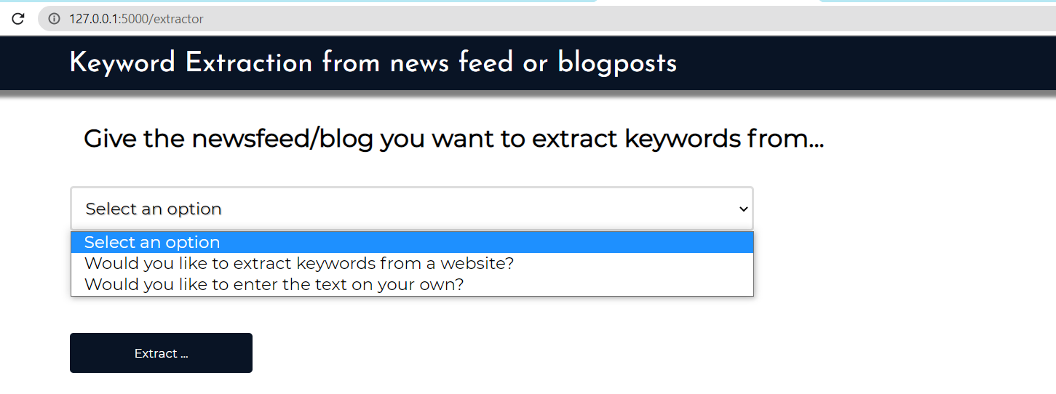

Slide 12
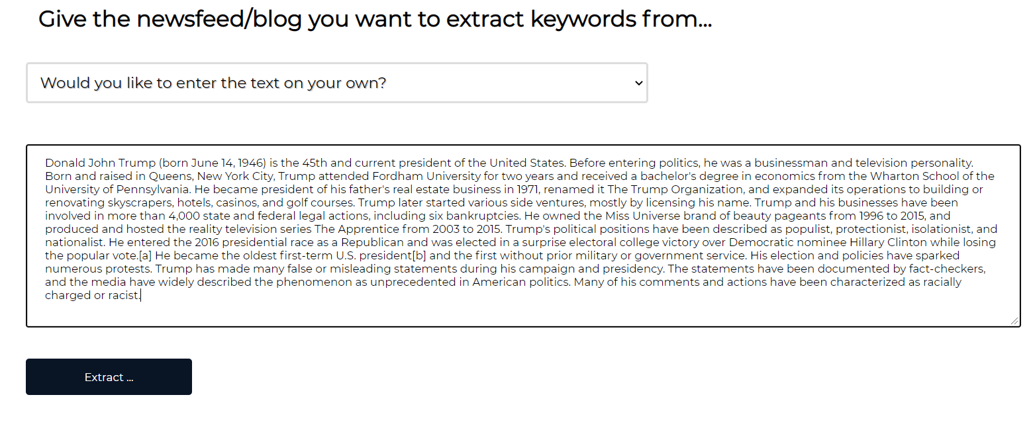
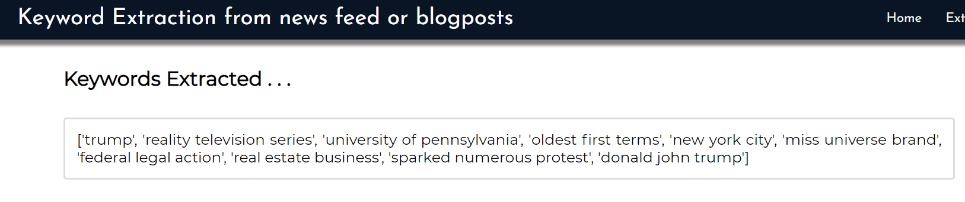

Slide 13

Thank You!

